Slide 1

Watch a video with instructions on how to use this template

Slide 2

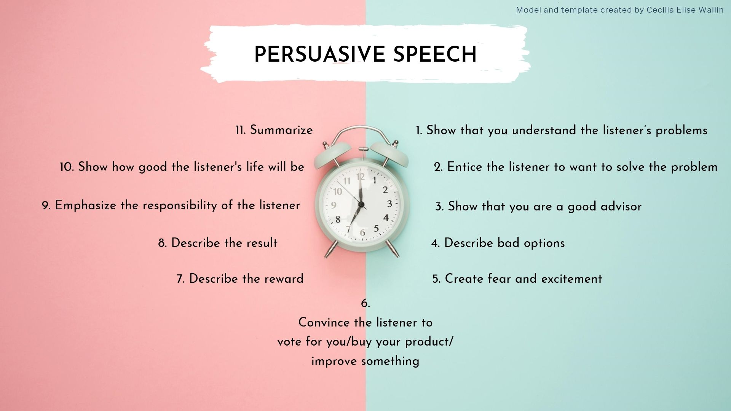


Model and template created by Cecilia Elise Wallin
I have distilled this model from the structure that I see in many political speeches, in marketing, and also in inspirational self-help videos. I have then, based on my observations, and with the support of the model "the hero's journey" (used to write stories), made this model for how a persuasive speech (or text) can be structured.
I often get annoyed when I watch political speeches, and video commercials, because I find them manipulative. The art of persuasion, and the model I am presenting in this video, can of course be used for both good and malicious purposes.
This video is not just made to help you write a great persuasive speech. Even more important is that you learn to detect if someone is trying to manipulate and deceive you.
Cecilia

Slide 3


Model and template created by Cecilia Elise Wallin
PERSUASIVE SPEECH
11. Summarize
1. Show that you understand the listener’s problems
10. Show how good the listener's life will be
2. Entice the listener to want to solve the problem
9. Emphasize the responsibility of the listener
3. Show that you are a good advisor
8. Describe the result
4. Describe bad options
7. Describe the reward
5. Create fear and excitement
6.
Convince the listener to
vote for you/buy your product/
improve something

Slide 4


Model and template created by Cecilia Elise Wallin
INSTRUCTIONS
You're going to write a persuasive speech.
Follow the instructions in this presentation.
Once you have written your speech, you will have the choice of giving the speech for a small group, or for the whole class.
Suggestions:
Write a political election speech (e.g. why you are the best presidential candidate or prime minister candidate)
Persuade the listener to buy a product (why is your product better than competitors' products?)
Persuade the listener to improve something (for example, you can persuade the listener to read more novels, eat more vegetables, exercise more...

Slide 5



Model and template created by Cecilia Elise Wallin
WRITE
A TITLE FOR YOUR
PERSUASIVE SPEECH HERE
FÖRNAMN EFTERNAM, KLASS

Slide 6

Model and template created by Cecilia Elise Wallin
  1. Make the listener feel like a hero. Show that you understand the listener's problem (before you type a text here, you'll need to decide which problem to solve for your audience).

Slide 7
Model and template created by Cecilia Elise Wallin
2. Here you entice the listener to want to solve their problem.

Slide 8



Model and template created by Cecilia Elise Wallin
3. Here you show that
you are a good advisor that the listener can have confidence in.

Slide 9


Model and template created by Cecilia Elise Wallin
4. Here you describe
possible solutions that do not work. (If you're writing a political election speech, you can write why the other parties' solutions aren't working. If you're selling a product, write why your competitors' products aren't working well. If you’re persuading your listener to improve something, explain why the listener's own attempts to solve the problem haven't worked.)

Slide 10

Model and template created by Cecilia Elise Wallin
5. Here you create fear and excitement by describing how bad it will be if the listener does not choose to solve the problem in the way that you suggest.

Slide 11


Model and template created by Cecilia Elise Wallin
6.
This is the turning point.
Convince the listener to vote for you/buy your product/improve something.

Slide 12

Model and template created by Cecilia Elise Wallin
7. Describe the reward. Here you will show how good the audience's lives will be when they have voted for you / bought your product / implemented the improvement.

Slide 13


Model and template created by Cecilia Elise Wallin
8. Describe the happy fulfilling lives you audience will get when they have made you president/bought your product/followed your advice.

Slide 14

Model and template created by Cecilia Elise Wallin
9. Here you emphasize the responsibility of the listener. Here you can also show how fantastic the listener's life will be when she/he have voted for you / bought your product / implemented the improvement.

Slide 15



Model and template created by Cecilia Elise Wallin
10. Here you can continue to show how fantastic the listener's life will be when he/she have voted for you / bought your product / implemented the improvement.

Slide 16

Model and template created by Cecilia Elise Wallin
11. Summarize what the listener has learned from listening to your speech.

Slide 17
Model and template created by Cecilia Elise Wallin
PERSUASIVE SPEECH
11. Summarize
1. Show that you understand the listener’s problems
10. Show how good the listener's life will be
2. Entice the listener to want to solve the problem
9. Emphasize the responsibility of the listener
3. Show that you are a good advisor
8. Describe the result
4. Describe bad options
7. Describe the reward
5. Create fear and excitement
6.
Convince the listener to
vote for you/buy your product/
improve something

